Slide 1
MySQL Triggers
A trigger is associated to table events (INSERT, UPDATE,DELETE)
Its parameters depend on the event
It does not return anything
It cannot return data sets

Slide 2
Need For A Trigger
Let’s start with an example: a business rule states that whenever an employee’s salary is changed, the change must be recorded in a logging table.
We could create two procedures to do this: UPD_EMP_SAL to update the salary, and LOG_SAL_CHANGE to insert the row into the logging table.
And we could invoke LOG_SAL_CHANGE from within UPD_EMP_SAL, or invoke LOG_SAL_CHANGE separately from the calling environment.
But we don’t have to do this. Instead, we create a trigger.

Slide 3
Example of a Simple Trigger
From now on, whenever a SQL statement updates a salary, this trigger executes automatically, inserting the row into the logging table.
We say that the trigger automatically fires (i.e. executes) whenever the triggering event (updating a salary) occurs.
Cause and effect: the event occurs, and the trigger fires.

Slide 4
Triggers
You can write triggers that fire whenever one of the following operations occurs:
DML statements (INSERT, UPDATE, DELETE) on a particular table or view, issued by any user
DDL statements (CREATE or ALTER primarily) issued either by a particular schema/user or by any schema/user in the database
Database events, such as logon/logoff, errors, or startup/shutdown, also issued either by a particular schema/user or by any schema/user in the database

Slide 5
SQL Triggers
CREATE TRIGGER trigger-name trigger-time trigger-event ON table-name FOR EACH ROW trigger-action;
trigger-time ∈ {BEFORE, AFTER}
trigger-event ∈ {INSERT,DELETE,UPDATE}

Slide 6
Triggers
BEFORE INSERT – activated before data is inserted into the table.
AFTER INSERT- activated after data is inserted into the table.
BEFORE UPDATE – activated before data in the table is updated.
AFTER UPDATE - activated after data in the table is updated.
BEFORE DELETE – activated before data is removed from the table.
AFTER DELETE – activated after data is removed from the table.

Slide 7
DROP table s;
CREATE TABLE s (
staffid VARCHAR(5) PRIMARY KEY,
salary DECIMAL(6,2) NOT NULL,
work_done INTEGER NOT NULL,
bonus INTEGER
);
delimiter //
CREATE TRIGGER salary_bi
BEFORE INSERT ON s
FOR EACH ROW
BEGIN
CASE
WHEN new.work_done > 10 THEN SET new.bonus = 5000;
WHEN new.work_done > 5 THEN SET new.bonus = 2500;
WHEN new.work_done > 2 THEN SET new.bonus = 1000;
ELSE
SET new.bonus = 0;
END CASE;
END//
delimiter ;
insert into s(staffid,salary,work_done) values ('s01', 100.0, 4);
Trigger_time: BEFORE, AFTER
Trigger_Event: INSERT, UPDATE, DELETE
Alias: OLD, NEW

Slide 8
MySQL Triggers
The OLD and NEW keywords enable you to access columns in the rows affected by a trigger.
In an INSERT trigger, only NEW.col_name can be used --there is no old row.
In a DELETE trigger, only OLD.col_name can be used -- there is no new row.
In an UPDATE trigger, you can use OLD.col_name to refer to the columns of a row before it is updated and NEW.col_name to refer to the columns of the row after it is updated.
A column named with OLD is read only. You can refer to it, but not modify it. A column named with NEW can be referred to if you have the SELECT privilege for it.

Slide 9
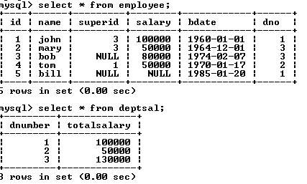
SQL Triggers: An Example
We want to create a trigger to update the total salary of a department when a new employee is hired

Slide 10
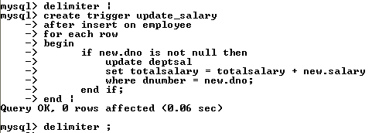
SQL Triggers: An Example
Create a trigger to update the total salary of a department when a new employee is hired:
The keyword “new” refers to the new row inserted

Slide 11
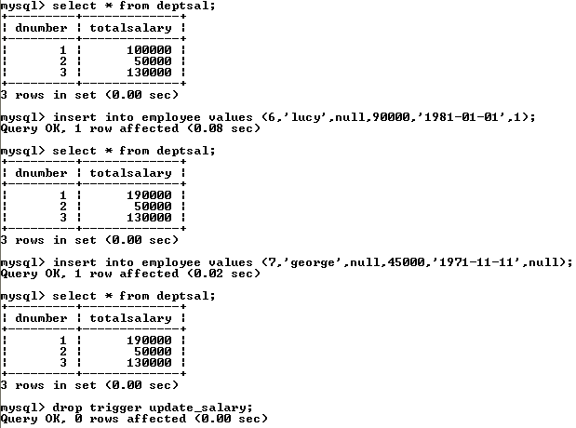
totalsalary increases by 90K
totalsalary did not change

Slide 12
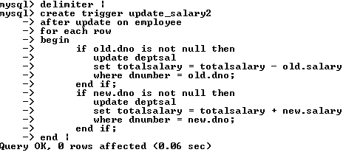
SQL Triggers: An Example
A trigger to update the total salary of a department when an employee tuple is modified:

Slide 13
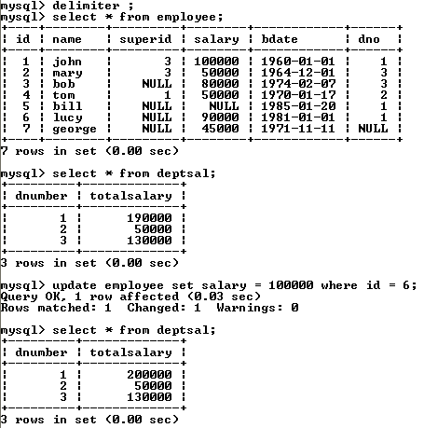

Slide 14
SQL Triggers: An Example
A trigger to update the total salary of a department when an employee tuple is deleted:

Slide 15
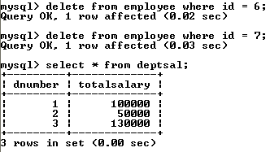
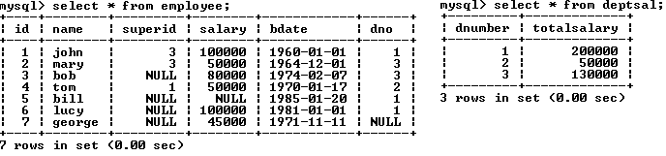

Slide 16
SQL Triggers
To list all the triggers you have created:
mysql> show triggers;

